Slide 1
Database design
Issue of database design and
Entity-Relationship model

Slide 2
Database design
System analysis 🡪 database requirements
How to mapping real world to database system
E-R model
A bridge between real world and database system
What is E-R model
Why E-R model
E-R model and E-R diagram
Summary of E-R diagram notation
Constraints on Relationship Types:
Cardinality ratio constraint
Participation constraint

Slide 3
E-R Model Concepts
Entities
Entity types
Entity type schema
Attributes
key attributes
Derived attribute
Relationship
Relationship types
Relationship instance
Degree of a Relationship type
Binary
ternary

Slide 4
Relationship as attributes
Role names and recursive relationships
Role
Recursive
Constraints on Relationship Types:
Cardinality ratio constraint (1:1, 1:n, m:n)
Participation constraint (total, partial)
Structural constraints: (min, max)
min = 0 🡪 partial participation
max > 0 🡪 total participation
Weak entity type

Slide 5
Summary of ER diagram notation
symbol
meaning
Entity type
attribute
Key attribute
Multi-value attribute
Derived attribute
Composite attribute

Slide 6
symbol
meaning
Relationship type
Identifying relationship type
Weak entity type
E1
R
E2
Total participation of E2 in R
1
N
E1
R
E2
Cardinality ratio 1:N for E1:E2
(min, max)
Structure constraint (min, max) on
Participation of E2 in R
R
E2

Slide 7
Rule of transfer ER diagram to Relational database schema
Rule 1: An entity type
Rule 2: composite attributes
Rule 3: multi-value attributes
Rule 4: relationship (1:N)
Rule 5: relationship (1:1)
Rule 6: relationship (M:N)
Rule 7: weak entity

Slide 8
Rule1 : An Entity Type ; Rule2 : composite attribute
Mapping each attributes to a relational table schema exclusive multi-value and attributes
EMPLOYEE
Employee ( fname, minit, lname, ssn, bdate, sex, address, salary)
DEPARTMENT
Department ( d-number, d-name)
PROJECT
Project ( p-number, p-name, p-location)

Slide 9
Rule3 : multi-value attribute
Create a table for multi-value attribute with the key attribute of original entity type
DEPARTMENT
Department ( d-numer, d-name)
DEPT-LOCATION
Dept-location ( d-number, d-location)

Slide 10
Rule4 : relationship (1:N)
將 relationship 放在 N 方, 此 relationship 是把 1 方的 key attribute 放在 N 方 (成為 foreign key) 形成
Relationship: Works_for
N
1
EMPLOYEE
Work_for
DEPARTMENT
(1,1)
(4, n)
EMPLOYEE
Employee ( fname, minit, lname, ssn, bdate, sex, address, salary, d_number)
DEPARTMENT
Department ( d-numer, d-name)

Slide 11
Relationship: controls
N
1
PROJECT
controls
DEPARTMENT
(1, 1)
(0, n)
PROJECT
Project ( p-number, p-name, p-location, d-number)
DEPARTMENT
Department ( d-number, d-name)

Slide 12
Relationship: supervision
subordinate
supervisor
N
1
EMPLOYEE
supervision
EMPLOYEE
(0,1)
(0, n)
EMPLOYEE
Employee ( fname, minit, lname, ssn, bdate, sex, address, salary, d_number, sup-ssn)

Slide 13
Rule5 : relationship (1:1)
將 relationship 放在 total 方, 此 relationship 是把 partial 方的 key attribute 放在 total 方 (成為 foreign key) 形成
Each attributes of Relationship will be an attribute of total side
Relationship: manages
partial
total
1
1
EMPLOYEE
manages
DEPARTMENT
(0,1)
(1, 1)
EMPLOYEE
start date
Employee ( fname, minit, lname, ssn, bdate, sex, address, salary, d_number)
DEPARTMENT
Department ( d-numer, d-name, mgr-ssn, mgr-start-date)

Slide 14
Rule6 : relationship (M:N)
將 relationship 獨立成為一個 table, 其 primary key 是由雙方 primary key 組成
Relationship: works-on
M
N
EMPLOYEE
Works-on
PROJECT
(1, n)
(1, n)
hours
Employee ( fname, minit, lname, ssn, bdate, sex, address, salary, d_number)
Project ( p-number, p-name, p-location, d-number)
Works-on ( emp-ssn, p-number, hours-per-week)

Slide 15
Rule7 : weak entity
將 partial key of week entity 結合 其所依附的 key attribute of entity type 形成
primary key
Weak entity: dependent
EMPLOYEE
Dependent-of
DEPENDENT
(0, n)
(1, 1)
Employee ( fname, minit, lname, ssn, bdate, sex, address, salary, d_number)
dependent ( emp-ssn, dependent-name, sex, bdate, relationship)

Slide 16
p.k.
Employee ( fname, minit, lname, ssn, bdate, sex, address, salary, d_number, sup-ssn)
f.k.
f.k.
p.k.
Department ( d-numer, d-name, mgr-ssn, mgr-start-date)
f.k.
f.k.
Dept-location ( d-number, d-location)
p.k.
Project ( p-number, p-name, p-location, d-number)
p.k.
f.k.
f.k.
Works-on ( emp-ssn, p-number, hours-per-week)
p.k.
f.k.
dependent ( emp-ssn, dependent-name, sex, bdate, relationship)
p.k.

Slide 17
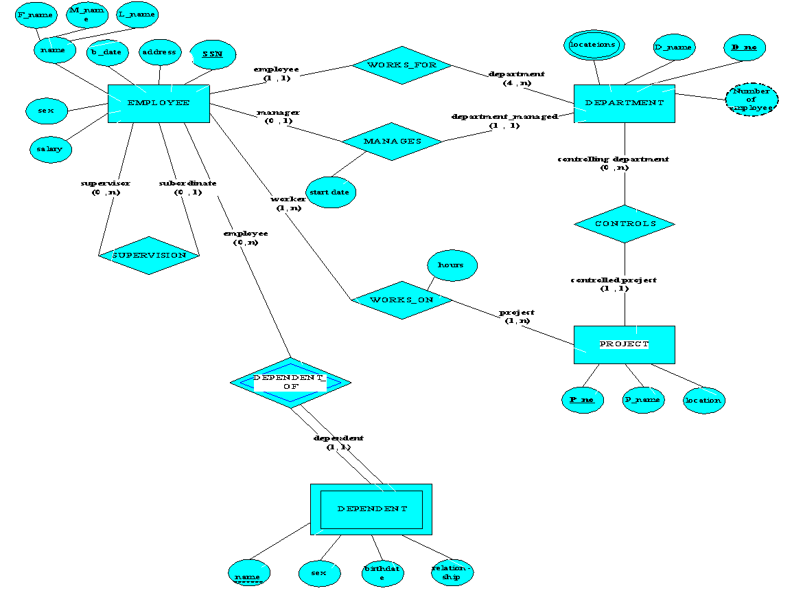

Slide 18
三元關係(Ternary relationships)
一對一對一 (one-to-one-to-one)
一對一對多 (one-to-one-to-many)
一對多對多 (one-to-many-to-many)
多對多對多 (many-to-many-to-many)
轉換方式:
將關係中所有個體都轉換程資料表，再將三元關係轉換成一個資料表，並以三元關係端的主鍵加入新產生的資料表，而主鍵的型成依不同類型有不同組成。

Slide 19
Example of one-to-one-to-one

Slide 20
Example of many-to-many-to-many
Mapping Ternary Relationship Type: For each n-ary ( > 2 ) Relationships create a new relation to represent the relationship. The primary key of the new relation is the combination of the primary keys of the participating entities that hold the N (many) side. In most cases of an n-ary relationship all the participating entities hold a many side.

Slide 21
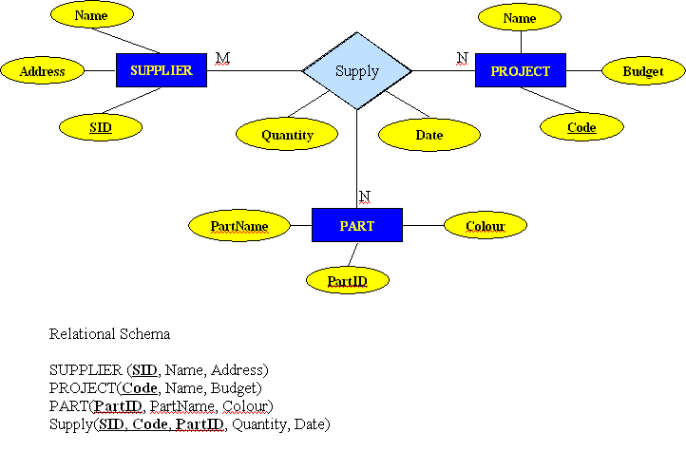
Figure : Mapping of Ternary Relationship Type

